Slide 1
MACHINE LEARNING BASIC CLUSTERING
Sindhu Wardhana
Ade Satya Wahana
Aris Budi Santoso
Leonard Yulianus

Slide 2
Definition
Clustering adalah sekumpulan teknik untuk membagi data ke dalam grup atau cluster;
Cluster adalah kumpulan objek data
Memiliki kemiripan dengan antara objek dalam satu cluster;
Memiliki perbedaan dengan objek lain di luar cluster;
Clustering termasuk dalam kategori Unsupervised Learning
Data tidak memiliki label/ predefined class

Slide 3
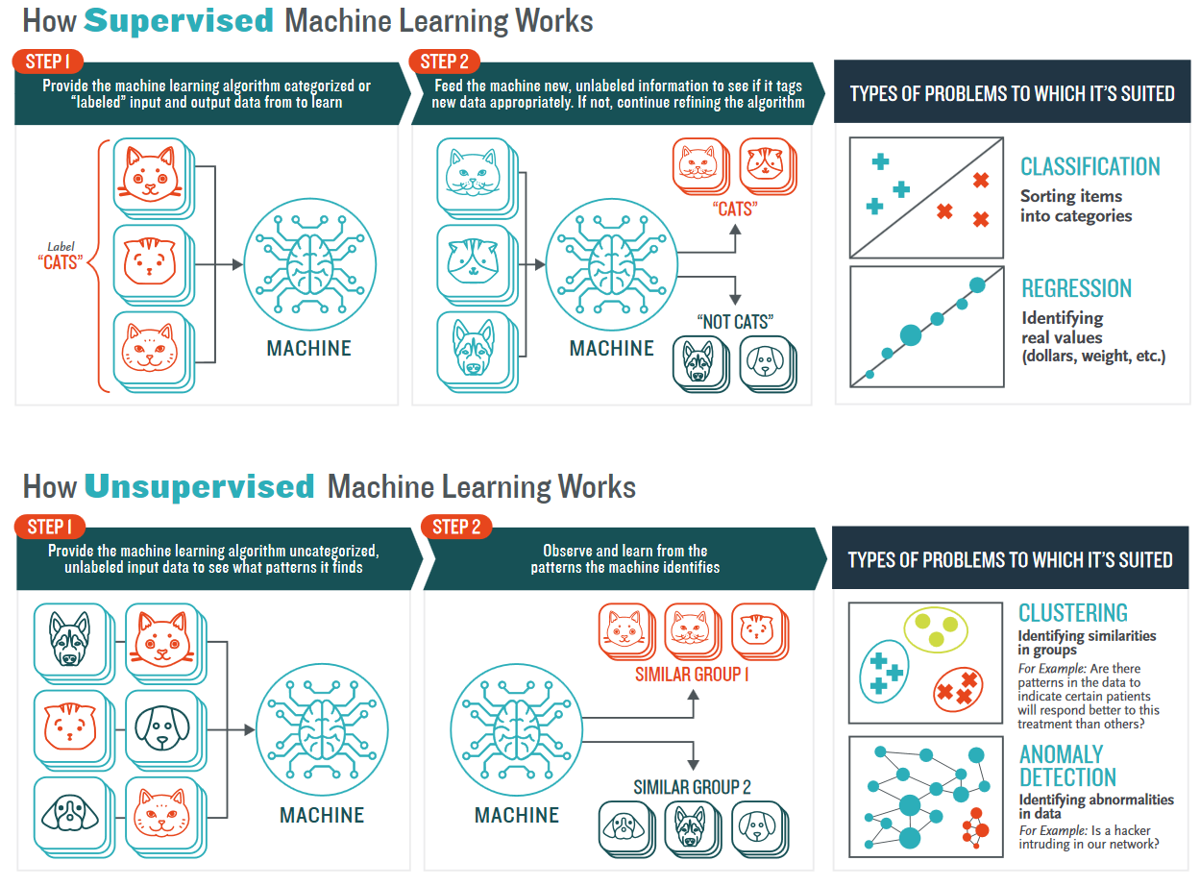
UNSUPERVISED LEARNING

Slide 4
The Advantages
Growing importance in a number of ﬁelds
Easier to obtain unlabeled data than labelled data
subgroups of breast cancer patients grouped by their gene expression measurements
groups of shoppers characterised by their browsing and purchase histories
movies grouped by the ratings assigned by movie viewers
topic modelling of text document (NLP)

Slide 5
The Challenges
more subjective than supervised learning
No simple goal for analysis
Have some issues
The number of subgroups (clusters)
The computer have to learn how to do something that we don’t tell it how to do
The learning (or inference) procedure is hard
The diﬀerent results via K-means with diﬀerent random initialisations
How to assess the performance of the unsupervised learning methods?

Slide 6
Clustering Algorithm

Slide 7
Clustering Approaches
Partitional Clustering
Perlu menentukan jumlah kluster
Iterasi untuk menempatkan data ke dalam cluster
K-Means
Hierarchical Clustering
Pembentukan cluster dilakukan secara hirarki
Agglomerative : Bottom-up
Menggabungkan dua titik yang memiliki kemiripan ke dalam sebuah cluster
Divisive : Top-down
Mulai dari sebuah cluser besar kemudian dibagi
Density Based Clustering
Pembentukan cluster dilakukan berdasar kepadatan titik data pada suatu area;
Antara cluster dipisahkan oleh area dengan kepadatan titik data yang rendah;
Density-Based Spatial Clustering of Applications with Noise (DBSCAN)

Slide 8
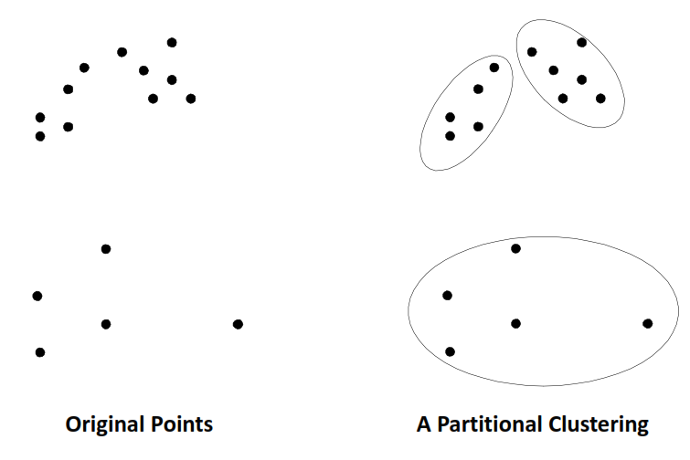
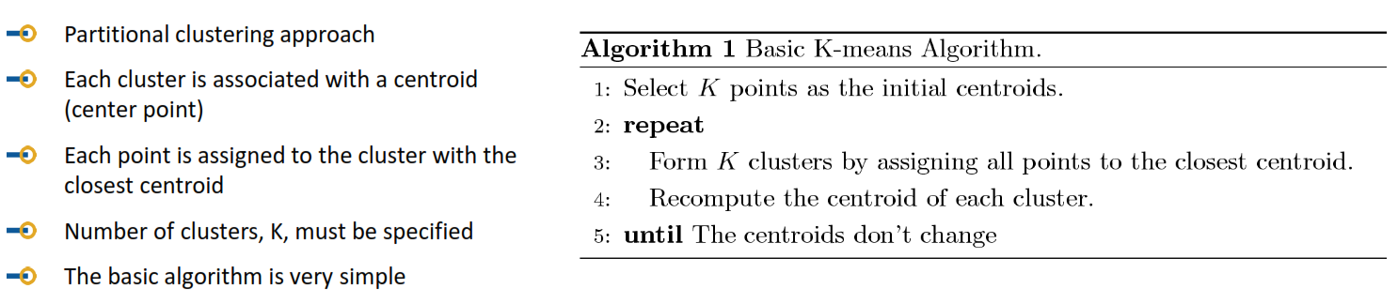
Partitioning Clustering (K-means)

Slide 9
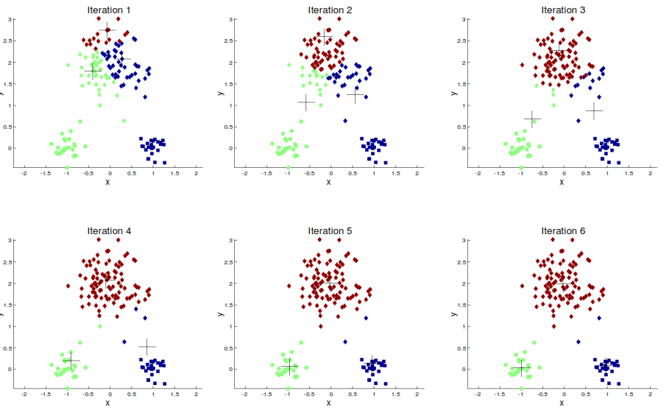
K-Means Algorithm

Slide 10
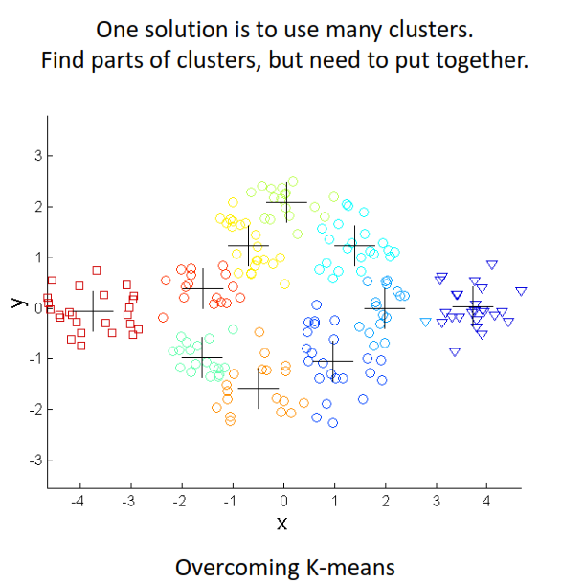
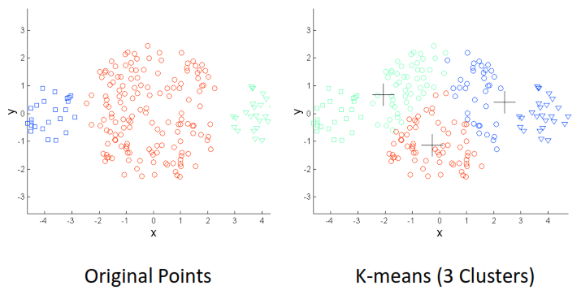
K-Means Limitation
Try kmeans with labeled data (original points)
The result is different
Size difference

Slide 11
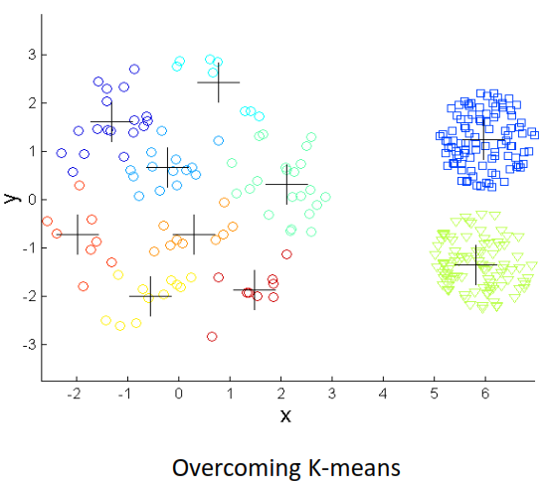
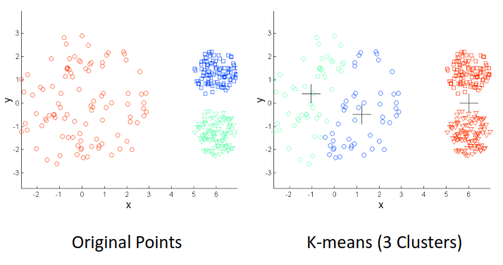
K-Means Limitation
Try kmeans with labeled data (original points)
The result is different
Density difference

Slide 12
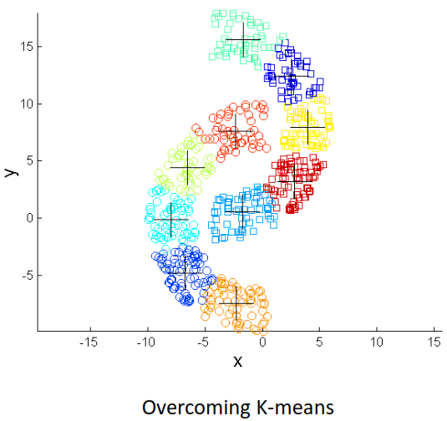
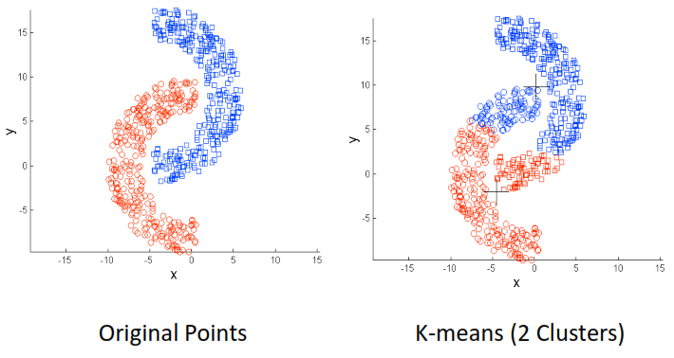
K-Means Limitation
Try kmeans with labeled data (original points)
The result is different
Non-globular Shapes

Slide 13
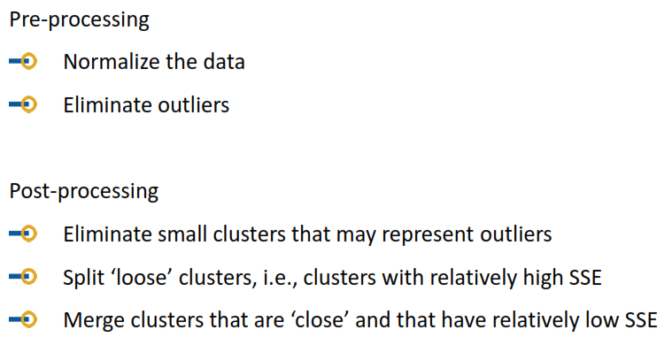
Pre and Post Processing

Slide 14
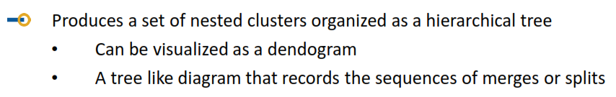
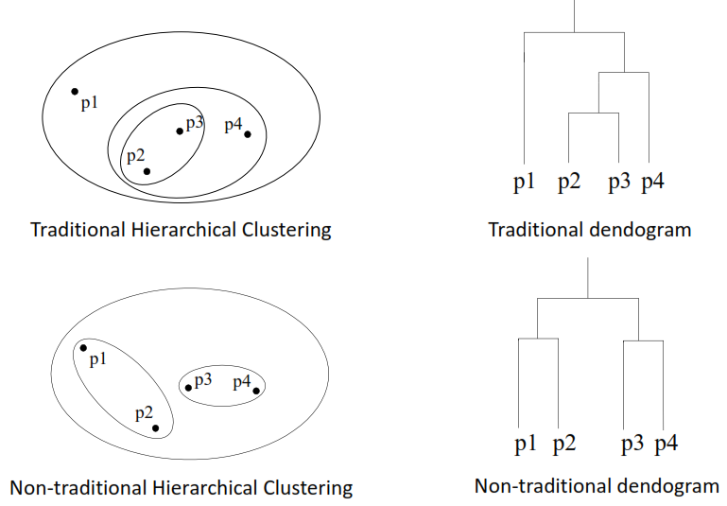
Hierarchical Clustering

Slide 15
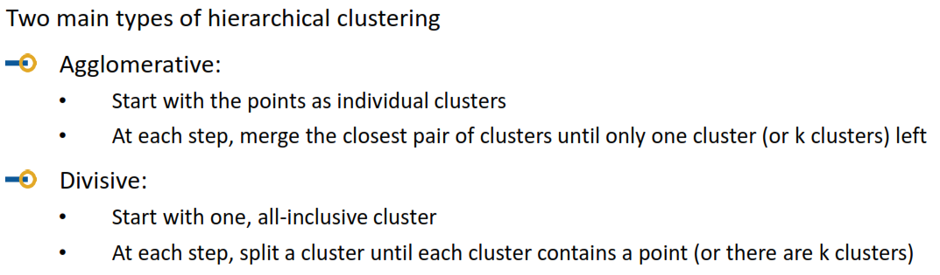
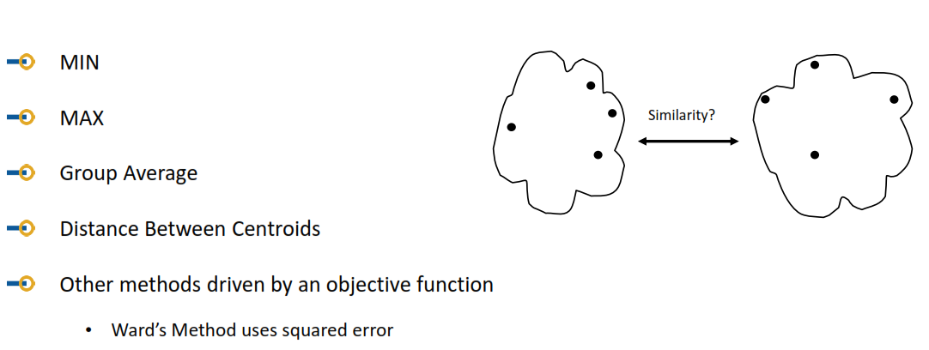
Hierarchical Clustering
How to decide closest pair??

Slide 16
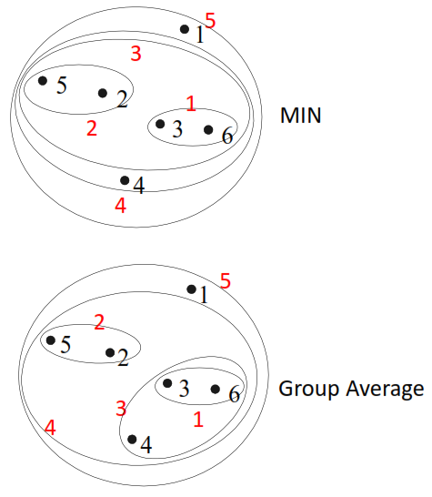
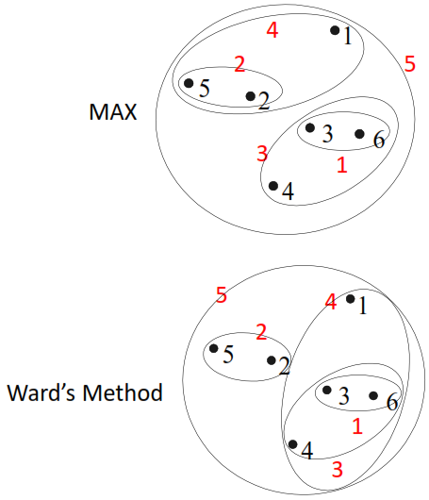
Similarity Approach Comparison
Less susceptible to noise and outliers
Bias towards globular clusters
Tends to break large cluster
Can handle non-elliptical shapes
Sensitive to noise and outliers
Less susceptible to noise and outliers
Bias towards globular clusters

Slide 17
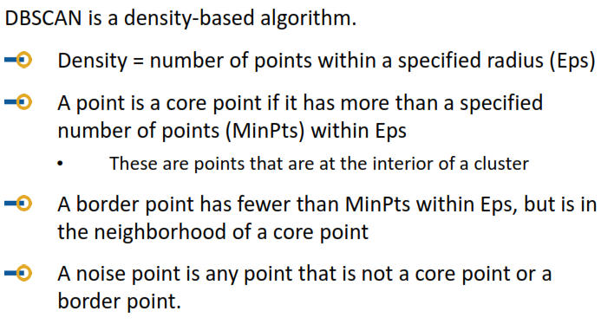
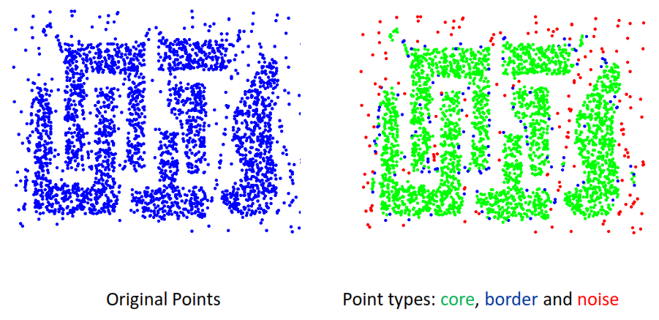
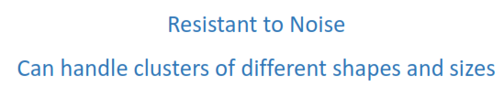
Density Based Clustering
Eps = 10, MinPts = 4

Slide 18
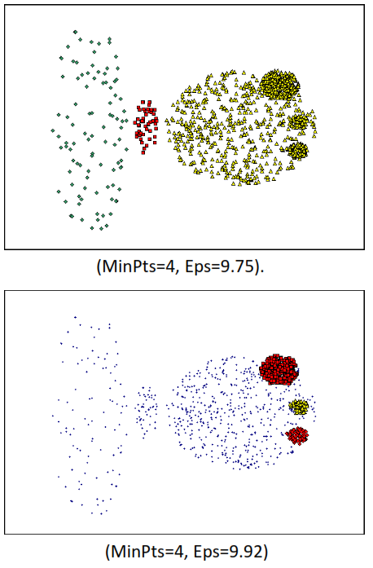
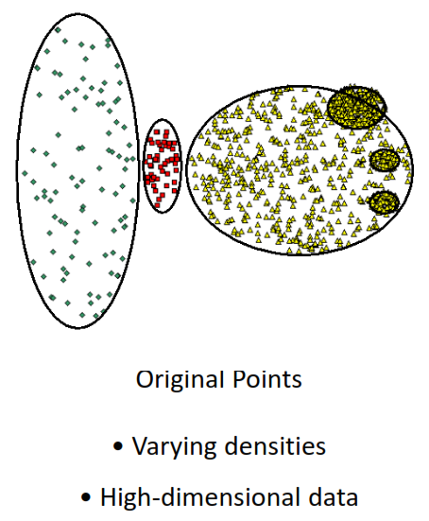
Density Based Clustering
Doesn’t Work Well

Slide 19
Use Case Clustering

Slide 20
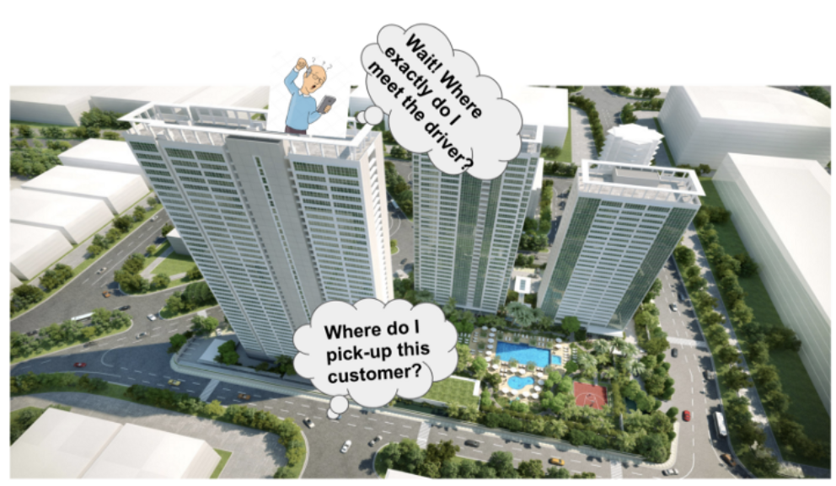
Study Case (GOJEK Meeting Points)

Slide 21
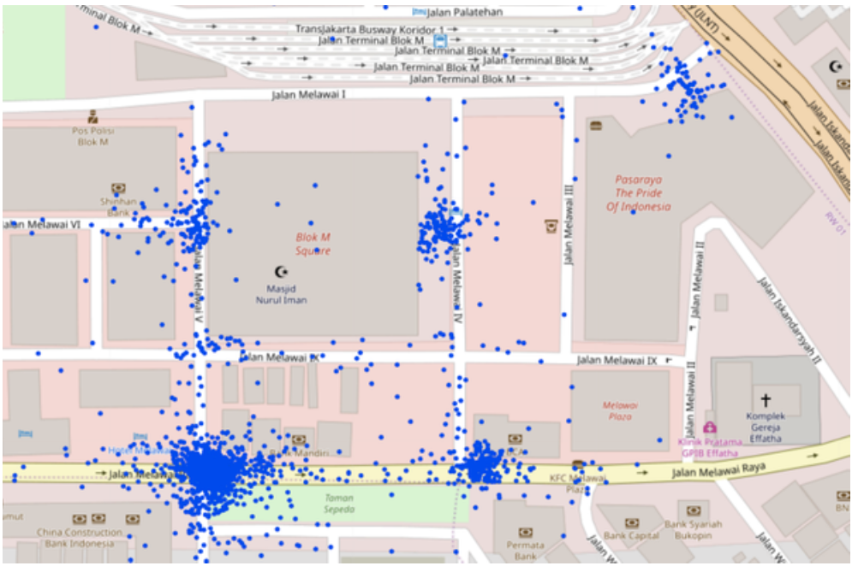
Project’s Target
Determine meeting point (gates) of any Place of Interest (POI)
based on historical driver pick up data
Clustering
POI Example: Blok M Square

Slide 22
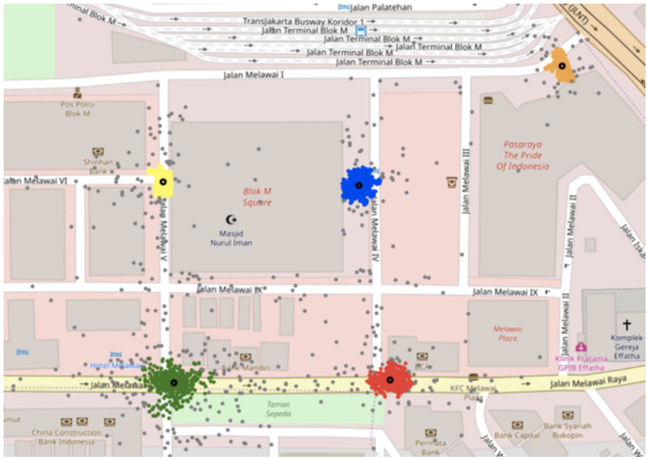
Using DBSCAN
After some hyperparameter tuning (eps and min_samples)
The result is 5 clusters for determining gates on Blok M Square
Looks ok

Slide 23
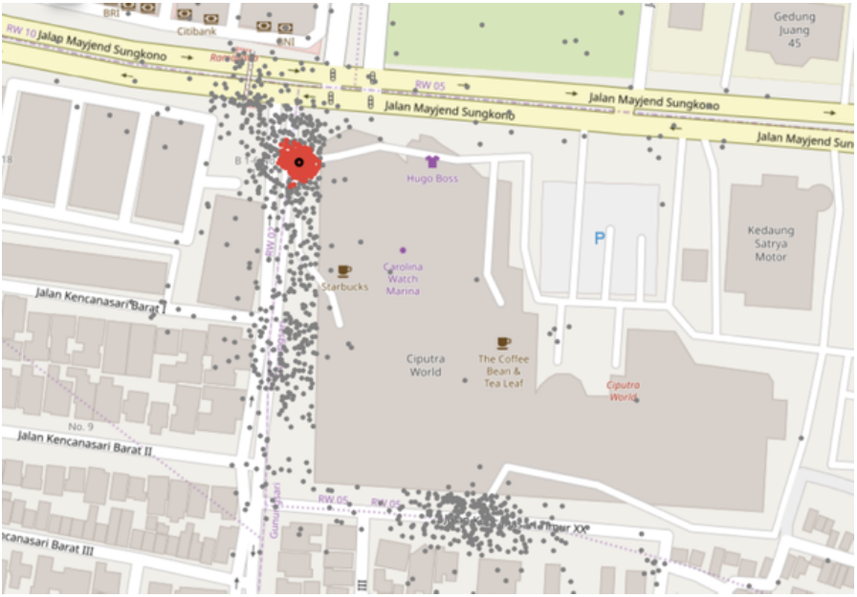
But it is not okay on different POI
POI : Ciputra World
Datapoints are spread so model cant determine cluster

Slide 24
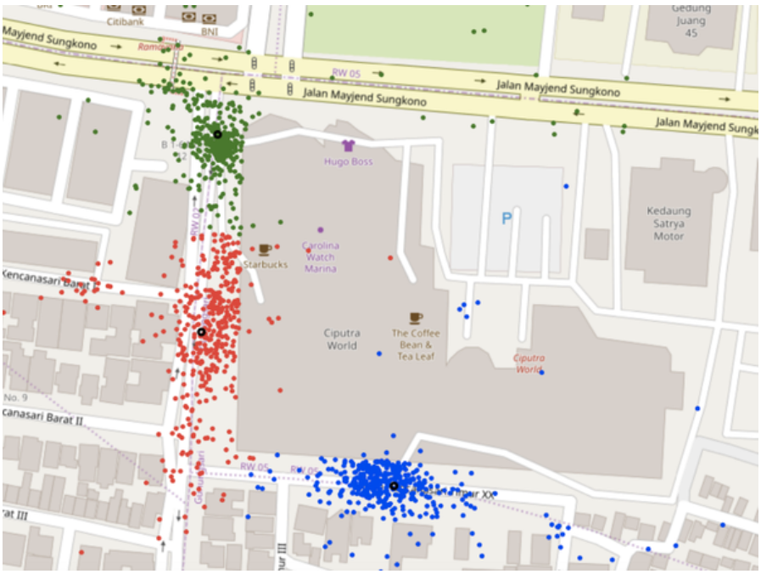
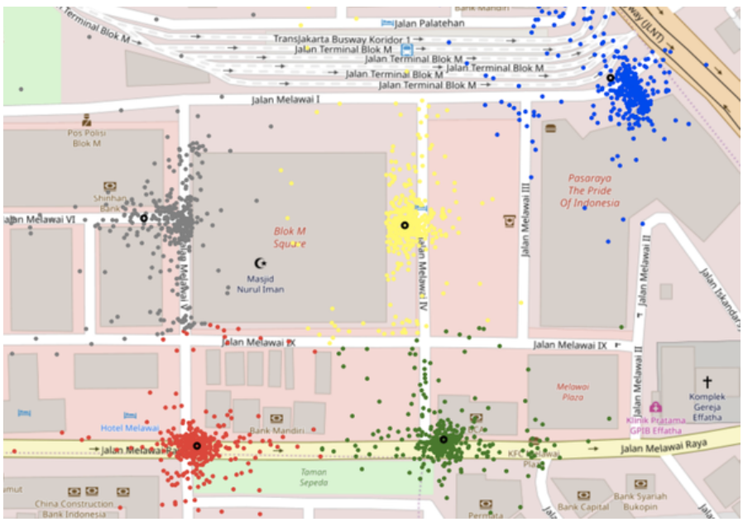
Using KMeans
Ciputra World
Blok M Square
Different POI may have different number of gates, but Kmean has a fix value of K
So, how to find best K value for each POI

Slide 25
Clustering Evaluation

Slide 26
Clustering Evaluation
Mengukur kedekatan dalam cluster, dan pemisahan antar cluster yang berbeda
Cluster yang baik : Compact, Separated
Ukuran evaluasi clustering:
Sum of Squared Error
Silhouette Index
Davies Bouldien Index

Slide 27
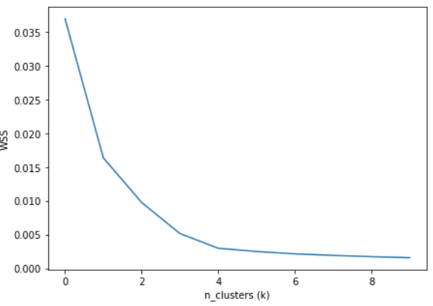
Analytical Computation of K
Find diminishing point (elbow) on WSS curve
WSS (Within-cluster Sum of Squared) Approach
Sum of squared error of each datapoint on a same cluster
Optimal K value is between 4 and 6

Slide 28
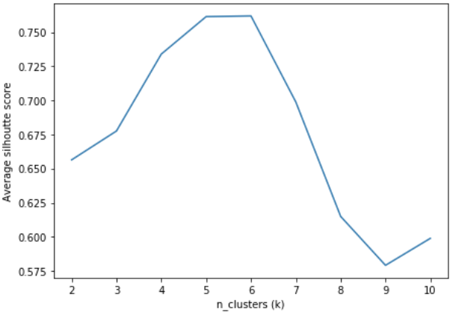
Analytical Computation of K
Find the maximum point of average silhouette score
Silhouette Score Approach
The silhouette value measures how similar a point is to its own cluster (cohesion) compared to other clusters (separation).
Optimal K value is 5 or 6

Slide 29
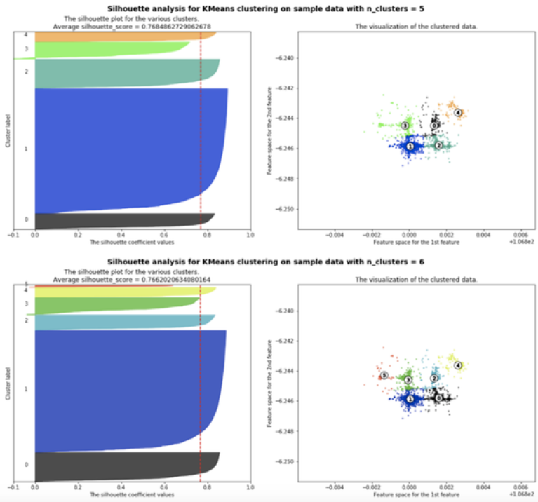
Compare K = 5 and K = 6
K=5 gives a little bit more silhouette point
K=6 makes 1 additional but not too significant cluster (red #5)
So, better to choose K = 5

Slide 30
Next Step
Automate the process of finding optimal K-value for analysing different POI
Give name of each gate (cluster centroid/mean), so it is easier for drivers and passengers to locate the gate
NLP case

Slide 31

CONTOH PENERAPAN PADA PYTHON
klik di sini

Slide 32

TERIMA KASIH

